Slide 1
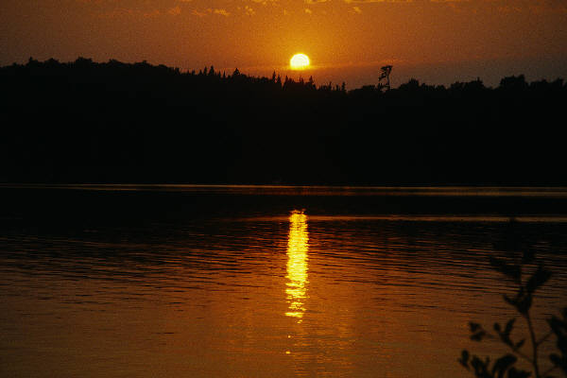
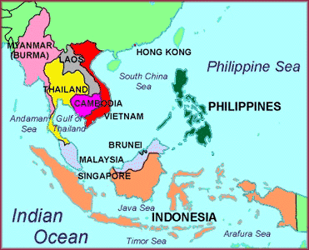
REGION ONE
Made up of 2 major Regions:
Region One:
Mainland SE Asia: several peninsulas, jut
S. between India & China
Today it is Myanmar, Thailand, Cambodia, Laos, Vietnam & part of Malaysia
Geography of SE Asia

Slide 2
Made up of 2 major Regions:
Region Two:
Consists of more than 20,000 islands scattered between Indian Ocean & South China Sea
Today it is Indonesia, Singapore, Brunei & the Philippines
REGION TWO
Geography of SE Asia

Slide 3
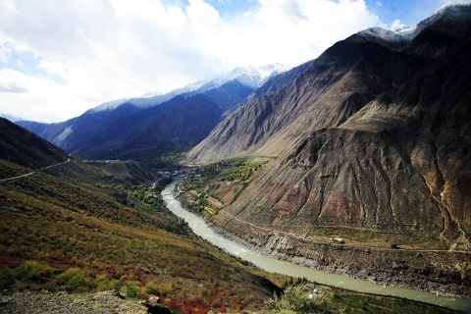
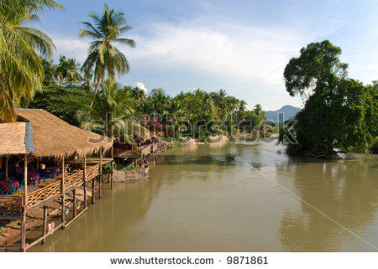
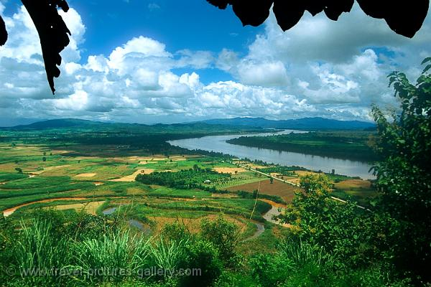
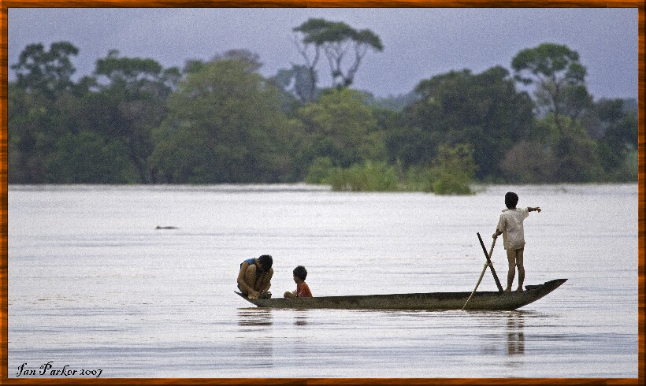
Mainland separated from rest of Asia–by mountains & plateaus
River Valleys home to early civilizations:

Slide 4
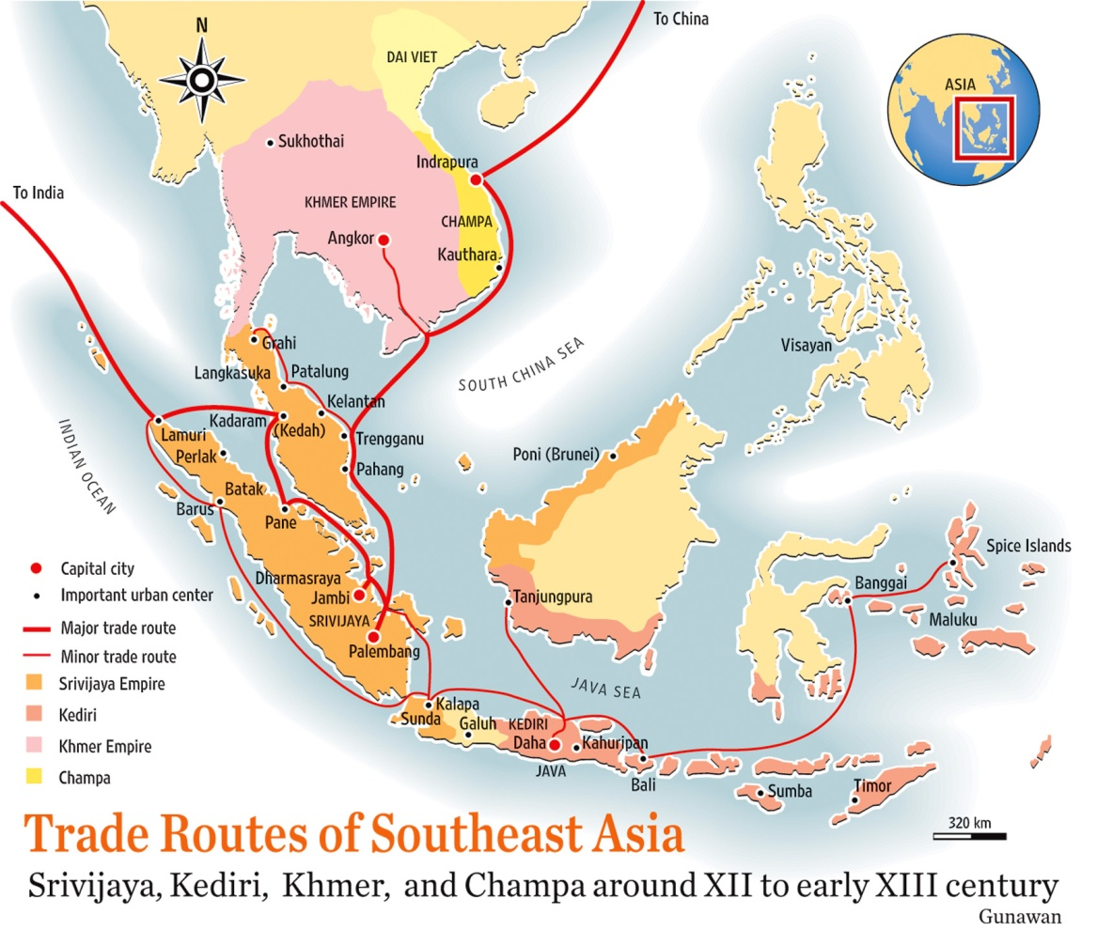
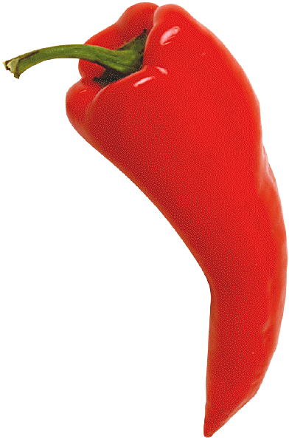
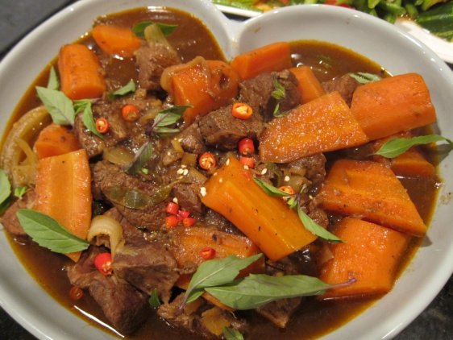
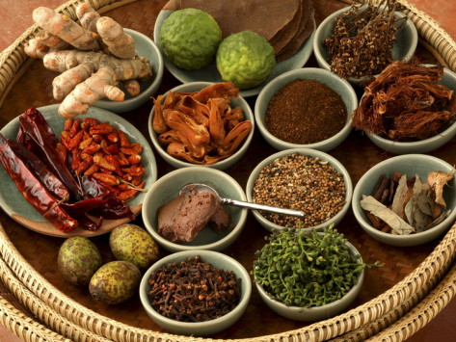
Trade Routes - determined by Monsoons (seasonal wind & rain)
Safe harbors became centers for trade
Trade network lined SE Asia, India, China, E. Africa, Middle East
First key product = Spices

Slide 5
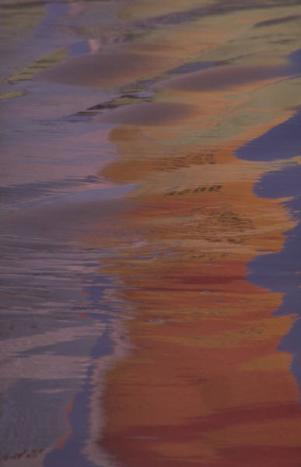
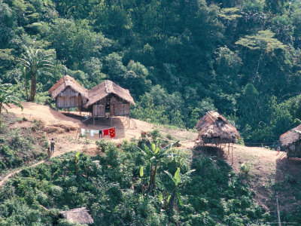
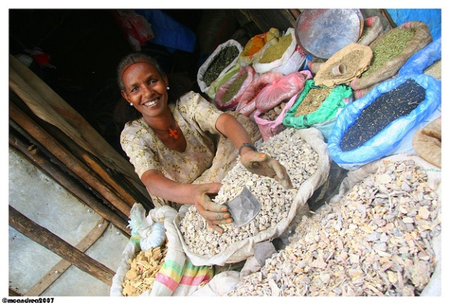
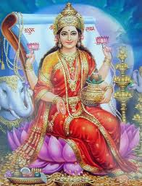
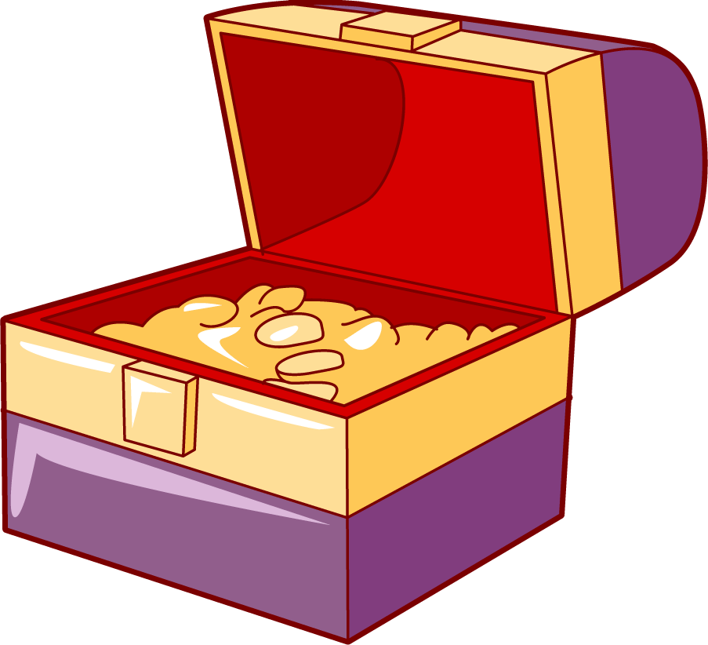
Early Traditions
Developed own culture before Indian & Chinese influences
Many diverse ethnic groups – isolated villages
Females able to take part in spice trade – some so wealthy - became rulers!
Matrilineal descent custom in SE Asia (carry family name and lineage from the women)

Slide 6
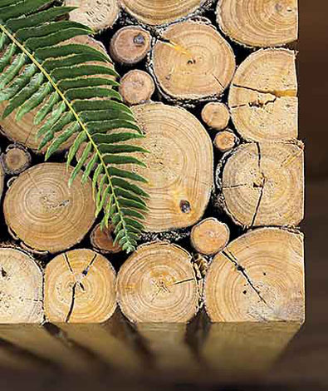
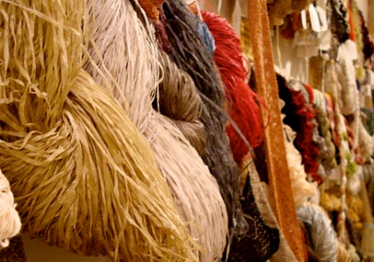
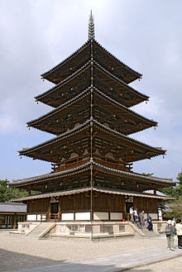
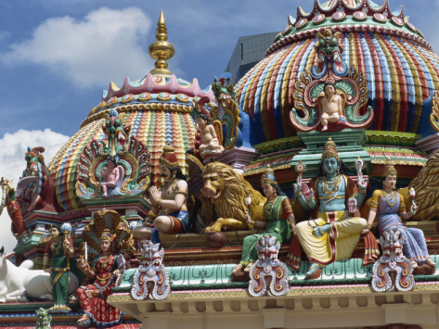
Indian Influences in Southeast Asia – reached peak 500 – 1000 A.D
Married into influential families
Traded products & raw materials (cotton, timber, spices, gold)
spreading Hinduism, Buddhism & Islam–
Many temples were built in the Indian style
PAGODA: A Hindu or Buddhist temple or sacred building, typically a many-tiered tower, in India and the Far East.
PAGODA
Sri Mariamman Temple, a Hindu Temple in Singapore

Slide 7
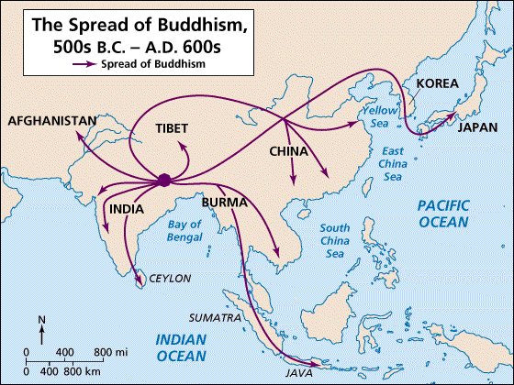
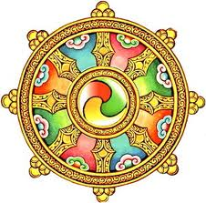
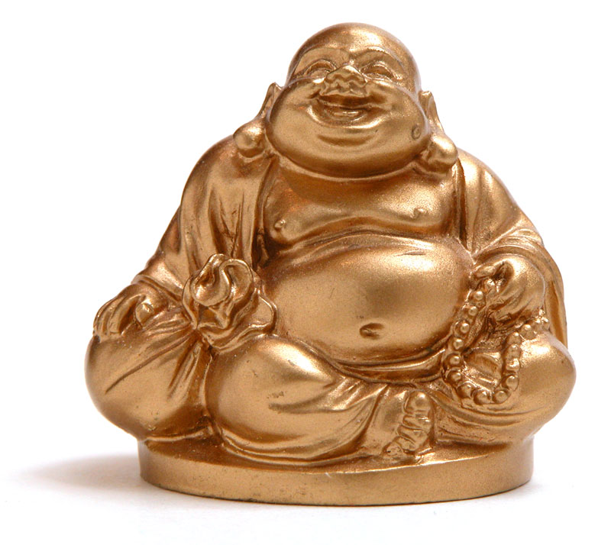
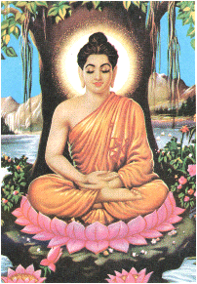
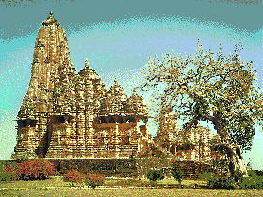
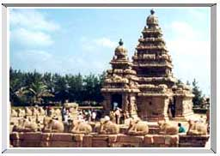

Slide 8
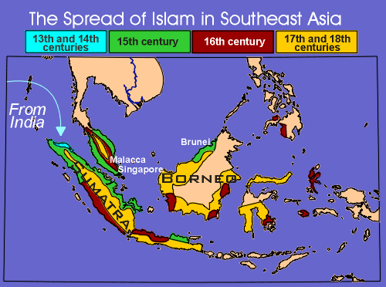
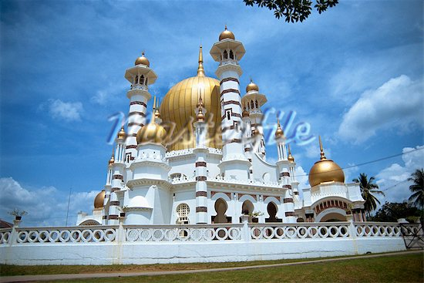
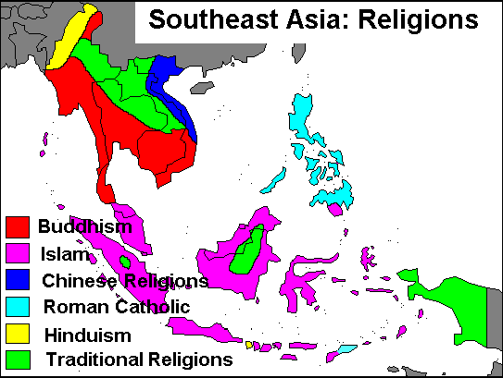
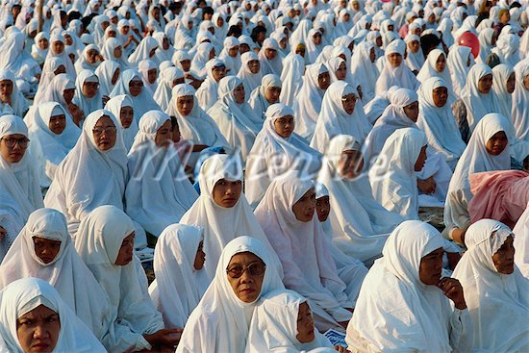
Mosque in Malaysia
Today Indonesia has the largest Muslim population in the world

Slide 9
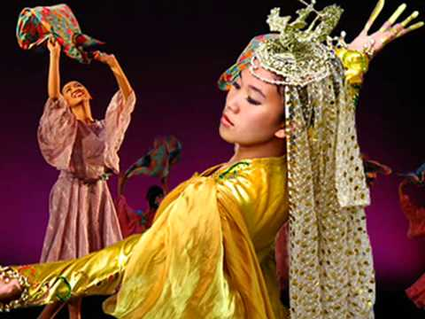
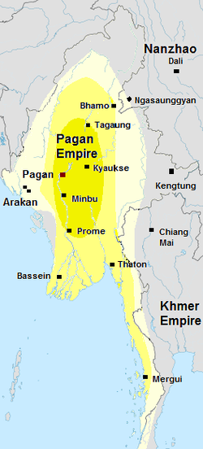
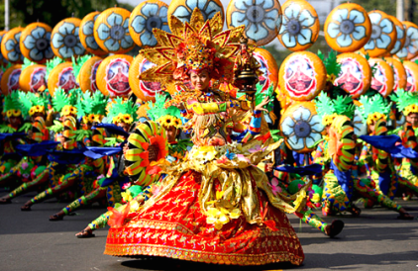
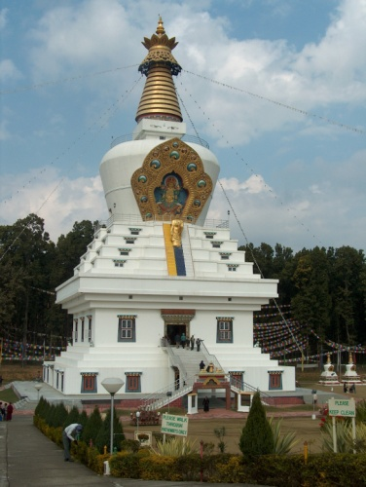
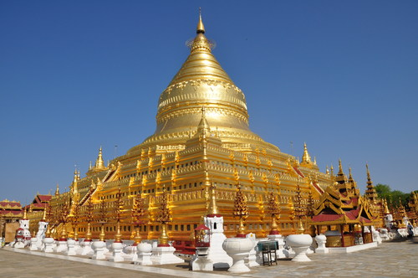
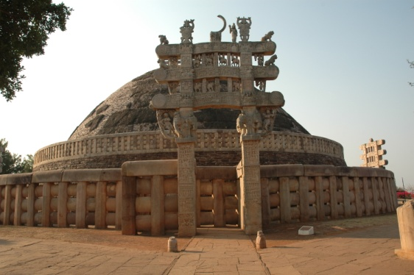
The Pagan Kingdom
Arose in present day Myanmar
1044 A.D. Kingdom was united
Buddhism major religion
Built many Buddhist temples
Stupas = dome shaped shrines/temples
Fell to conquering Mongols in 1287
Traditional Clothing
Shwezigon
Buddhist Pagoda/Stupa
In Myanmar
STUPAS

Slide 10
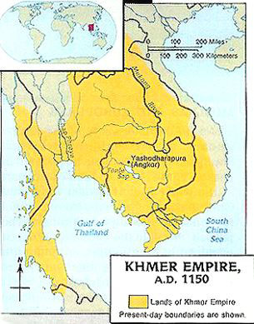
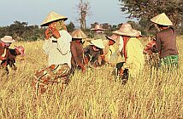
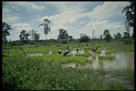
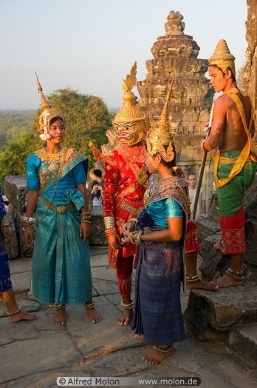
The most powerful Indian-influenced empire was the Khmer Empire
The Khmer Empire - located in what is now Cambodia
Controlled much of SE Asia
Adopted Hindu and Buddhist beliefs
Large irrigation system – year-round rice production
Growing population – increased tax revenues
Put wealth into public works: roads, reservoirs, hospitals
Built magnificent capital at Angkor – and many temples
Traditional Clothing

Slide 11
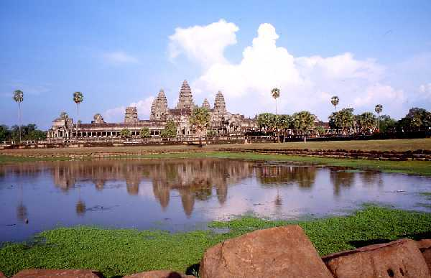
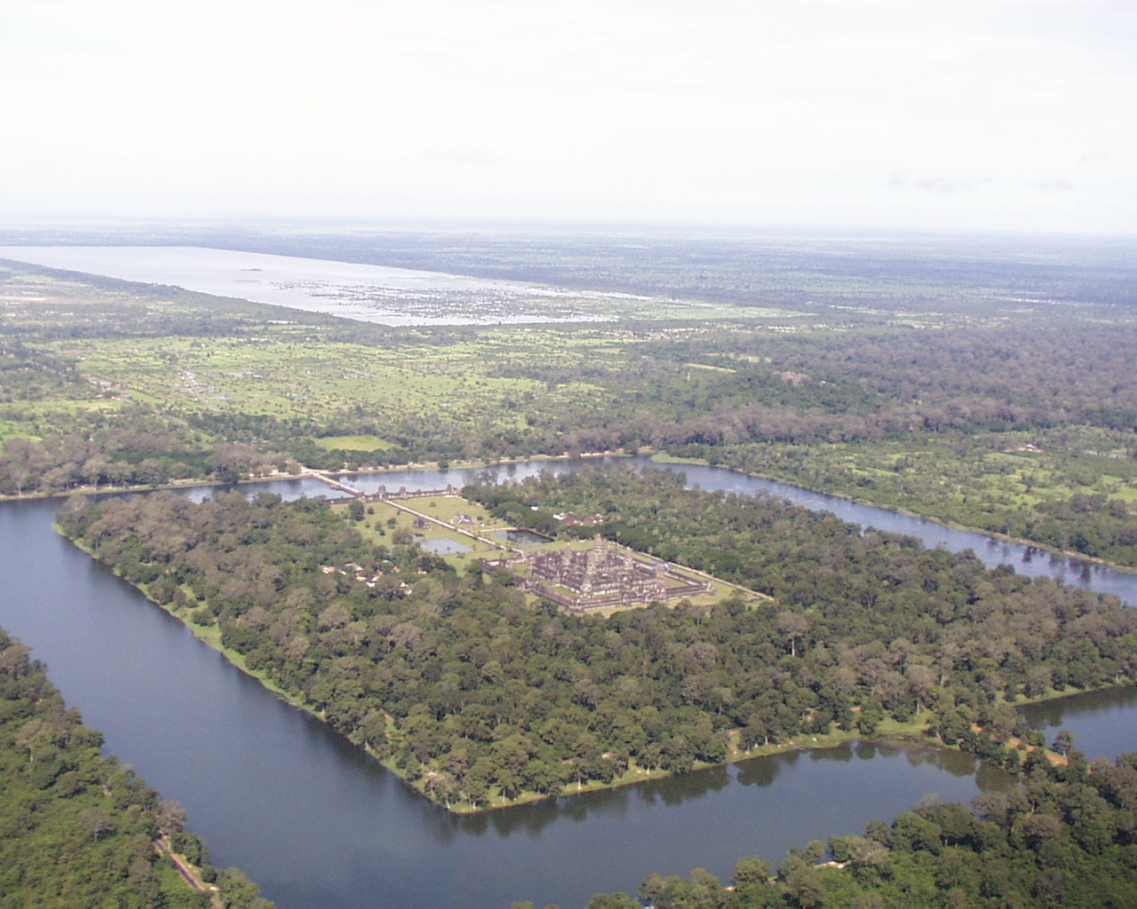
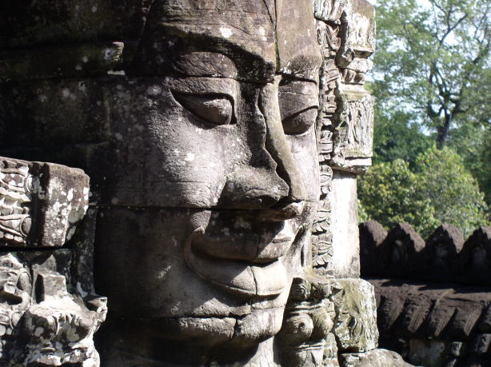
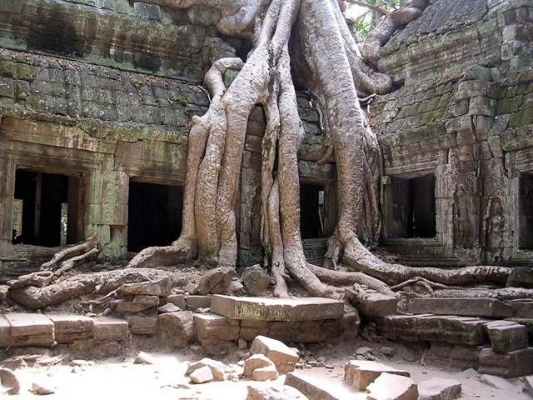
Most famous temple in Khmer Empire = Angkor Wat – built in 1100s
One square mile – surrounded by 3 mile moat
Intricate carvings

Slide 12
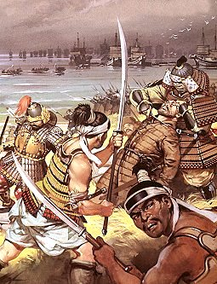
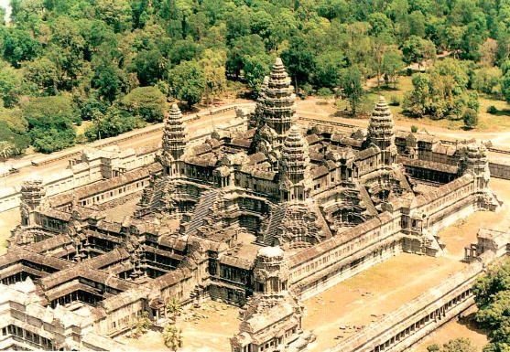
Great expense building the temple weakened Khmer Empire
Attacked by outside invaders – notably the Mongols
In 1400s conquered by Thai people south of China

Slide 13
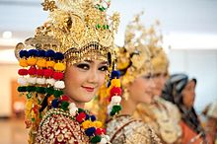
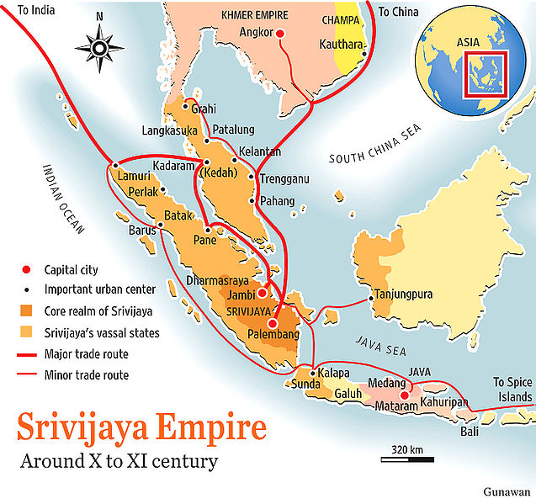
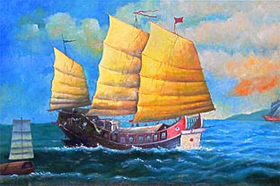
Srivijaya Empire Flourishes in Indonesia
Trading Empire 600s to 1200s
Vital to shipping
Blended Indian beliefs into own form of spirit-based worship
Later, Islam came to the islands
Traditional Clothing

Slide 14
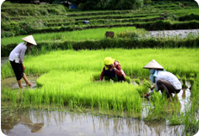
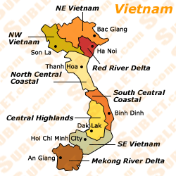
VIETNAM EMERGES
Red River Delta had irrigated rice paddies (fields) – provided food for growing population
111 B.C. Chinese Han armies conquered Northern Vietnam
Controlled for 1,000 years
Vietnamese absorbed & adopted:
Confucian ideas
Chinese Civil service program &bureaucracy
Chinese speaking & writing
Mahayana Buddhist beliefs & Daoism

Slide 15
With fall of China’s Tang Dynasty –Vietnam finally broke free of China in 939 A.D.
However, they remained a tributary state of China for years to come
Through all of that, the Vietnamese still Preserved their Identity
Trung Trac and her sister, Trung Nhi, rallied their troops to fight against the Chinese
PICTURE: General Ngô Quyền successfully ends Chinese occupation of Vietnam. This monumental victory took place at the River of Bạch Đằng in 938A.D.,
Traditional Clothing

